Slide 1

Requirement Engineering
UNIT II
Disclaimer:
Information included in this slides came from multiple sources. We have tried our best to cite the sources. Please refer to the References to learn about the sources, when applicable.
The slides should be used only for academic purposes (e.g., in teaching a class), and should not be used for commercial purposes.

Slide 2
Syllabus – Unit II
REQUIREMENT ENGINEERING
Software Requirements, User requirements, System requirements, Software Requirements Specification, Requirement Engineering Process, Requirements validation
SOFTWARE DESIGN
Abstraction, Modularity, Cohesion & Coupling, Scenario based modeling, Introduction to Unified Modeling Language (UML) and Data Flow Diagram ( DFDs).
Case Studies.

Slide 3
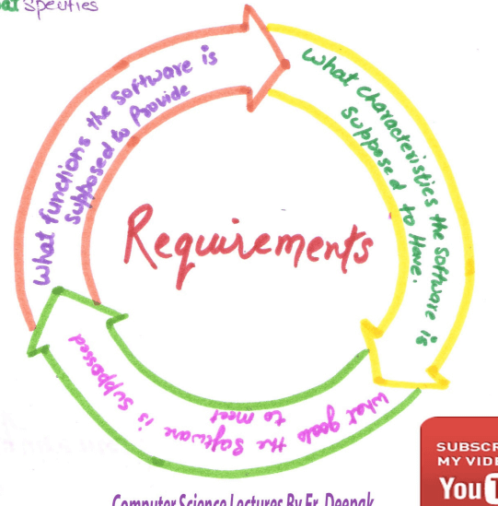
The Requirement Engineering
Requirements engineering is a process of gathering and defining of what the services should be provided by the system.

Slide 4
What is Requirements Engineering?
Requirements are description of features and functionalities of the system and convey the expectations of users from the software product.
The requirements can be obvious or hidden, known or unknown, expected or unexpected from client’s point of view.
Requirements engineering refers to the process of defining, documenting and maintaining requirements in the engineering design process.
It is a common role in systems engineering and software engineering.

Slide 5
Requirement Definitions and Specifications Example

Slide 6
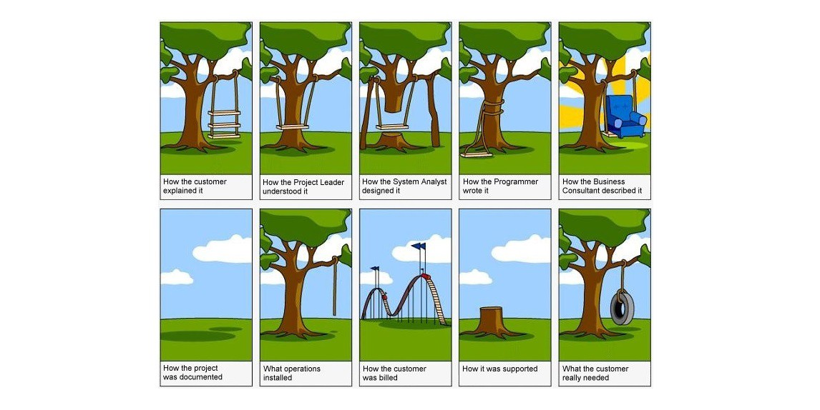
Ugly Face of Requirement Engineering

Slide 7
Requirement Engineering Steps
RE has overlapping steps :
Inception - in which the nature and scope of the system is defined.
Elicitation - in which the requirements for the software are initially gathered.
Elaboration - in which the gathered requirements are refined.
Negotiation -in which the priorities of each requirement is determined, the essential requirements are noted, and, conflicts between requirements are resolved.
Specification - in which the requirements are gathered into a single product, being the result of the requirements engineering.
Validation - in which the quality of the requirements (i.e., are they unambiguous, consistent, complete, etc.), and the developer's interpretation of them, are assessed.
Management - in which the changes that the requirements must undergo during the project's lifetime are managed.

Slide 8
Requirements Engineering steps
Inception— Ask a set of questions that establish …
Basic understanding of the problem
The nature of the solution that is desired
The effectiveness of preliminary communication and collaboration between the customer and the developer
The people who want a solution -Identify Stakeholders : Stakeholders can affect or be affected by the application’s actions, objectives and policies. End Users, Build Team and Authorities
Recognize multiple points of view

Slide 9
Requirements Engineering- Steps
Elicitation
Elicit requirements , identify problems from all stakeholders
Propose elements of the solution
The scope and negotiate different approaches,,
Understanding of the problem and volatility (requirements change over time )
Specify a preliminary set of solution requirements

Slide 10
Requirements Engineering- Steps
Elaboration
Create an analysis model that identifies data, function and behavioral requirements.
It is driven by the creation and refinement of user scenarios that describe how the end-user will act with the system.

Slide 11
Requirements Engineering- Steps
Negotiation
Identify Conflicting Requirements and reconcile these conflicts through a process of negotiation.
Stakeholders are asked to rank requirements and then discuss conflicts in priority.
Risks in each requirement are identified and analyzed.
Agree on a deliverable system that is realistic for developers and customers.
Specification : SRS or a prototype
It is the final work produced by the RE. It is serves as the foundation for subsequent S.E. activities.

Slide 12
Validation
A review mechanism that looks for
Errors in content or interpretation
Areas where clarification may be required
Missing information
Inconsistencies (a major problem when large products or systems are engineered)
Conflicting or unrealistic (unachievable) requirements.
Management
Set of activities that help the project team identify, control, and track requirements and changes to requirements at any time as the project proceeds.

Slide 13
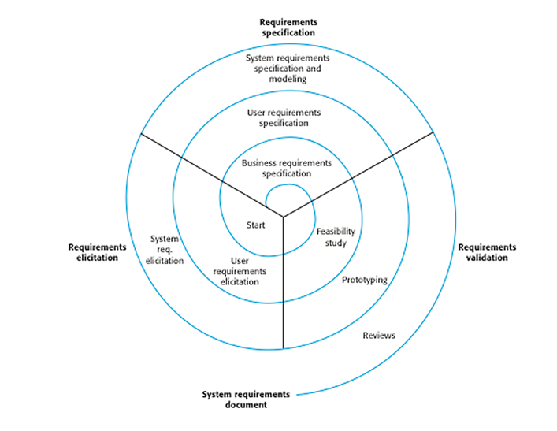
The process of requirements engineering
RE is an iterative process
Iterate first on
1. the user requirements
Elicitation
Specification
Validation,
and repeat the same steps
2. for the system requirements.

Slide 14
Requirements Evolution

Slide 15
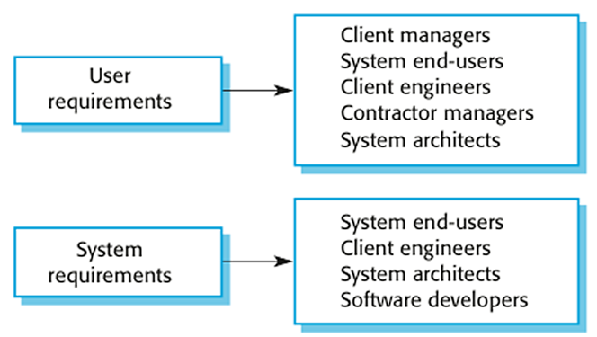
User and System Requirements
User need a high-level statements of the requirements, while system developers need a more detailed system specification.
Having different level of details is useful because it communicates information about the system being developed for different types of readers.

Slide 16
User and System Requirements
User Requirements : describes the services that the system should provide and the constrains under which it must operate.
more of generic requirements and Readable by everybody
Services and constraints of the system
In natural language or diagrams
Serve business objectives
System Requirements : gives a more detailed description of the system services and the operational constrains (how system will be used, programming languages etc)
This level of detail is needed by those who are involved in the system development
Useful for the design and development
Precise and cover all cases
Structured presentation

Slide 17
Example
User requirement: The library system should provide a way to allow a patron to borrow a book from the library.
System requirement: The library system should provide a withdraw interaction that allows a patron to withdraw a book given the isbn and copy number of the book to be withdrawn. The interaction fails if: the book is already withdrawn, the book is not in the library's collection, the patron has already withdrawn 5 books, the book is on hold by someone else.
Software Specification: A detailed software description which can serve as a basis for a design or implementation. Written for developers

Slide 18
RE Process
Requirement Engineering is the process of defining, documenting and maintaining the requirements.
A process of gathering and defining service provided by the system.
It ensures your software will meet the user expectations, and ending up with a high quality software.
It’s a critical stage of the software process as errors at this stage will reflect later on the next stages, which definitely will cause you a higher costs.
At the end of this stage an SRS is produced and validated with the stakeholders.

Slide 19
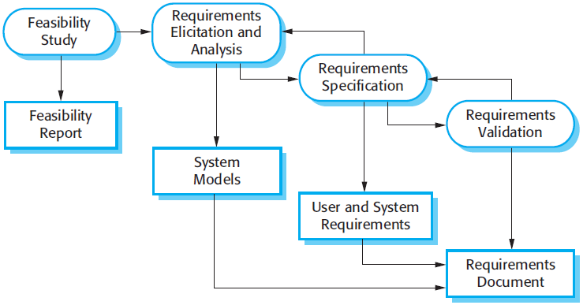
The RE process

Slide 20
RE Process
Feasibility study:
Check is made if the identified can be achieved using the given conditions
This step should be cheap and quick;
Requirements elicitation and analysis:
Deriving the system requirements through observation of existing systems, discussions with stakeholders, etc.
Can involve development of a system models and prototypes to understand the specified system
Requirements specification:
It’s the activity of writing down the information gathered during the elicitation and analysis activity into a document that defines a set of requirements.
Two types of requirements may be included in this document; user and system requirements.
Requirements validation:
It’s the process of checking the requirements for realism, consistency and completeness.
Goal is to discover errors in the requirements document.
When errors are found, it must be modified to correct these problems.

Slide 21
Types of Requirements
Functional requirements
Services the system should provide
What the system should do or not in reaction to particular situations
Non-functional requirements
Constraints on the services or functions offered by the system
Examples: Timing constraints, constraints on the development process (CASE, language, development method…), standards etc
Domain requirements
From the application domain of the system
May be functional or non-functional
Examples: Medicine, library, physics, chemistry

Slide 22
Bad Requirements
Missing Requirements –A functionality that is totally missing from the documentation.
“Error messaging” in case of data validation
not detailing the need for a certain link available as per the access rules on an application.
Conflicting Requirements – When two or more requirements expect the system to do different things that can’t possibly be done at the same time.
the business stakeholder might want to retrieve a 1000 records at a time in real-time whereas the technology stakeholder knows this is practically impossible and not feasible.
Incomplete/Unclear Requirements – Requirements that lack all the necessary information constitute this lot.
“The system should have the capability to filter search results”. The details around filter criteria is not been provided and thus raises unnecessary queries.
Ambiguous Requirements – A requirement statement that can be interpreted in different ways by different people.

Slide 23
Ambiguous Requirements
A client needed to be able to upload "large files." A solution was found where the platform could handle the "large files." Client was assured a solution was found and testing began. Client gave a feedback that the solution was not meeting their needs, was freezing and full of bugs.
To the client "large" meant 20-50GB and to our team and the platform provider "large" meant up to 5GB.
Trigger an automatic log out when a user attempts to download up to 5 times. Display is up to large screen size.
Is this 5 times including the 5th time or 4 times?
the page has a document that is in 5 parts
For the screen size, 720px may be large for some and 1280 may be large for some.

Slide 24
Requirements Checking
Validity. Does the system provide the functions which best support the customer’s needs?
Consistency. Are there any requirements conflicts?
Completeness. Are all functions required by the customer included?
Realism. Can the requirements be implemented given available budget and technology
Verifiability. Can the requirements be checked?

Slide 25
SOFTWARE DESIGN
SOFTWARE DESIGN
Abstraction, Modularity, Cohesion & Coupling,
Scenario based modeling,
SSAD ( ER diagram, Control Flow Diagram CFD , Data Flow Diagram DFD),
OOAD (Unified Modeling Language UML)- Modeling Language (UML)- Introduction to all Diagrams.

Slide 26
Software Design
Software design is a process to transform user requirements into some suitable form, which helps the programmer in software coding and implementation.
Software design usually involves problem solving and planning a software solution. This includes both a low-level component and algorithm design and a high-level, architecture design.
It’s the next step after RE

Slide 27
Software Design Levels
Software design yields three levels of results:
Architectural Design -
is the highest abstract version of the system.
It identifies the software as a system with many components interacting with each other.
High-level Design-
Breaks the Architectural Design into less-abstracted view of sub-systems and modules and depicts their interaction with each other.
Focuses on how the system along with all of its components can be implemented in forms of modules, each sub-system and their relation and interaction among each other.
Detailed Design-
Deals with the implementation part of what is seen as a system and its sub-systems
It defines logical structure of each module and their interfaces to communicate with other modules.

Slide 28
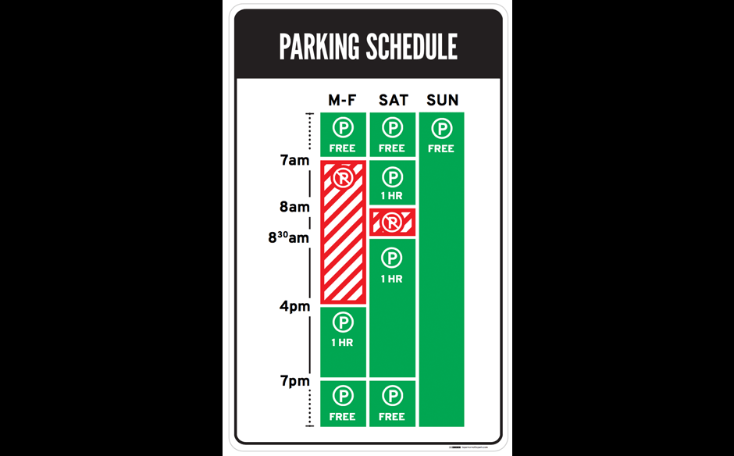
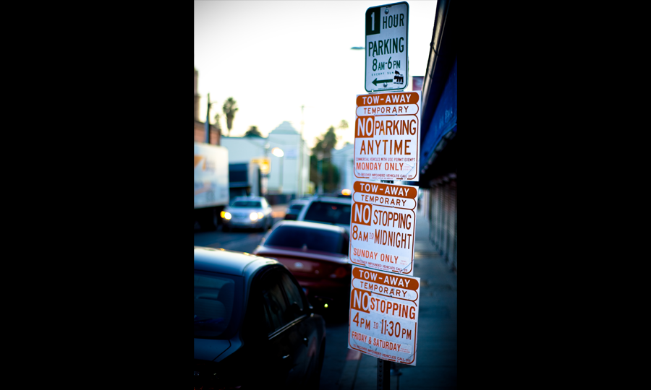
Good design and Bad Design

Slide 29
Good Design vs Bad Design
Good Design | Bad Design
1. Meets all technical requirements | 1. Meets only some technical requirements
2. Works all the time | 2. Works initially but stops working after a short time
3. Meets cost requirements | 3. Costs more than it should
4. Requires little or no maintenance | 4. Requires frequent maintenance
5. Is safe | 5. Poses a hazard to users
6. Creates no ethical dilemma | 6. Raises ethical questions

Slide 30
What is a good design?
A good design is focused.
A good design is effective and efficient in fulfilling its purpose.
It relies on as few external factors and inputs as possible, and these are easy to measure and manipulate to achieve an expected other output.
A good design is always the simplest possible working solution.

Slide 31
Abstraction
The principle of abstraction requires:
lower-level modules do not invoke functions of higher level modules.
Also known as layered design.
High Level Design: High-level design maps functions into modules such that:
Each module has high cohesion
Coupling among modules is as low as possible
Modules are organized in a neat hierarchy

Slide 32
Modularity
Modularity is a fundamental attributes of any good design.
Decomposition of a problem cleanly into modules:
Modules are almost independent of each other
Divide and conquer principle.
If modules are independent:
Modules can be understood separately,
Reduces the complexity greatly.
To understand why this is so,
Remember that it is very difficult to break a bunch of sticks but very easy to break the sticks individually.

Slide 33
Modularity
A module ideally should have high cohesion and low coupling:
Functionally independent of other modules to have minimal interaction with other modules.
Improves understandability and good design:
Complexity of design is reduced as different modules are understood in isolation:
A functionally independent module:
Can be easily taken out and reused in a different program.
Each module does some well-defined and precise function
The interfaces of a module with other modules is simple and minimal.

Slide 34
Modularity
In technical terms, modules should display:
high cohesion
low coupling.
Cohesion is a measure of:
Functional strength of a module.
A cohesive module performs a single task or function.
Coupling between two modules:
A measure of the degree of interdependence or interaction between the two modules.

Slide 35
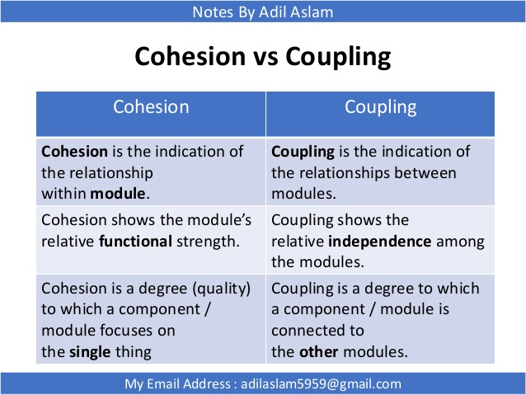
Cohesion and Coupling

Slide 36
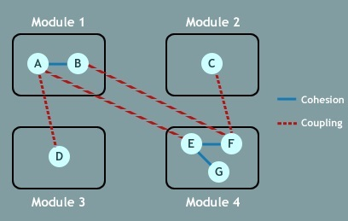
Cohesion and Coupling
Ideally good Software Design will promote Tight cohesion and Low coupling
- Changes in the system

Slide 37
Transition from Analysis to Design
Analysis: A process of extracting and organizing user requirements and establishing an accurate model of the problem domain.(WHAT)
Design: Process of mapping requirements to a system implementation that conforms to desired cost, performance, and quality parameters.(HOW)

Slide 38
Transition from Analysis to Design
Blurred line between analysis & design
Process of design leads to better understanding of requirements
Can be performed iteratively
No direct & obvious mapping exists between structured analysis and structured design.

Slide 39
Forward Engineering
“Forward engineering is the traditional process of moving from high-level abstractions and logical, implementation-independent designs to the physical implementation of a system."
[ElliotChikofsky and JamesCross, Reverse Engineering and Design Recovery: A Taxonomy, IEEE Software 7(1):13-17, 1990.]

Slide 40
Reverse Engineering
Analyzing software with a view to understanding its design and specification
May be part of a re-engineering process but may also be used to re-specify a system for re-implementation
Builds a program data base and generates information from this
Program understanding tools (browsers, cross-reference generators, etc.) may be used in this process

Slide 41
Reverse Engineering
“Reverse engineering” is the process of analysing a subject system with two goals in mind:
To identify the system's components and their interrelationships; and,
To create representations of the system in another form or at a higher level of abstraction."
[ElliotChikofsky and JamesCross, Reverse Engineering and Design Recovery: A Taxonomy, IEEE Software 7(1):13-17, 1990.]

Slide 42
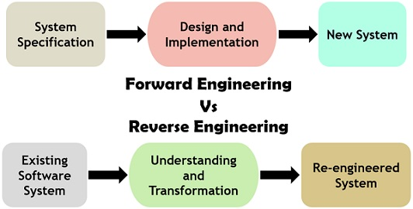
Forward vrs Reverse Engineering

Slide 43
Differences Between Forward Engineering and Reverse Engineering
Forward engineering begins with the system specification and includes the design and implementation of the developing system.
On the contrary, the initial step in reverse engineering starts with the existing system and the development technique for the replacement is based on interpretation.
It is always certain to generate a by-product of forward engineering
but in the case of reverse engineering, several ideas are generated about the requirement not necessarily generate a product.
Forward engineering is prescriptive in nature where the developers need to follow particular rules for the proper results.
On the other hand, reverse engineering is adaptive where the engineer has to discover what the developer actually did.
Forward engineering consumes more time as compared to the reverse engineering.
The final product of forward engineering must be complete and exact. As against, reverse engineering model can be imperfect, retrieved partial information is still useful.

Slide 44
Two Approaches for Analysis & Design
Traditional Approach: SSAD(System Structured Analysis and Design)
Structured Analysis (SA), resulting in a logical design, drawn as a set of data flow diagrams
Structured Design (SD) transforming the logical design into a program structure drawn as a set of structure charts
OOAD(Object Oriented Analysis and Design)
Designing systems using self-contained objects and object classes

Slide 45
Structured Analysis
Is a development method to understand the system and its activities in a logical way.
It is a systematic approach that analyze and refine objectives of an system
It has following attributes −
It is graphic which specifies the presentation of application.
It divides the processes so that it gives a clear picture of system flow.
It is logical rather than physical
It is an approach that works from high-level overviews to lower-level details.
Structured Analysis Tools and techniques used for system development:
Data Flow Diagrams
Entity Relation Diagram
Data Dictionary
Decision Trees
Structured English
Pseudocode

Slide 46
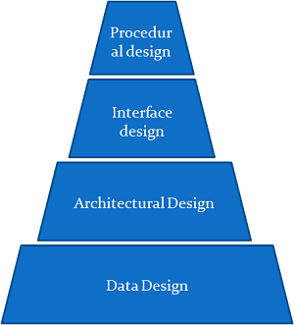
Structured Analysis
Data design transforms ERD in to data structures
Architectural design - higher-level structure of the system that depicts the relationship between the modules of the system
Interface design defines interaction of people with the system
Procedural design transforms the modules of the system architecture in to Pseudo-code or Flow Chart

Slide 47
Control Flow Diagrams
A control flow diagram helps to understand the detail of a process.
It shows us where control starts and ends and where it may branch off in another direction, given certain situations.
Let's say you are working on software to start a machine. What happens if the engine is flooded, or a spark plug is broken? Control then changes the flow to other parts of the software.
We can represent these branches with a diagram. The flow diagram is helpful because it can be understood by both stakeholders and systems professionals.
Although some of the symbols might not be fully understood by the layperson, they can still grasp the general concept.

Slide 48
Control Flow Diagrams
Even to the non-IT person, it is fairly clear that the software will attempt to start engines.
If errors occur, then it will branch off into different directions.
The general flow should make sense
Try to start the engines
Run a problem check
Display alerts if it can't start
Disengage the clutch
Try restarting
But what about the vertical lines and dashed arrows?

Slide 49
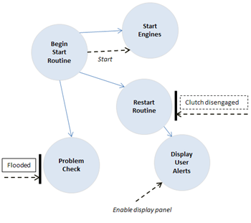
Control Flow Diagram
Keeping with the idea of an engine-start program, the following shows flow through the software:
Vertical Bar
The vertical bar indicates input or output from the current control specification.
Think of the bar as a window INTO or OUT OF the entire specification/flow. Additional notes, including an arrow, indicate further detail of the flow through that window.

Slide 50
Control Flow Diagram
Dashed Arrow
The input to the problem check step is Flooded
The input into the restart routine is clutch disengaged

Slide 51
Data Flow Diagrams
The DFD (also known as a bubble chart) is a hierarchical graphical model of a system that shows the different processing activities or functions that the system performs and the data interchange among these functions.
Each function is considered as a processing station (or process) that consumes some input data and produces some output data.
The system is represented in terms of the input data to the system, various processing carried out on these data, and the output data generated by the system.

Slide 52
Data Flow Diagram
A data flow diagram is a graphical representation that depicts information flow and the transforms that are applied as data move from input to output.
The data flow diagram may be used to represent a system or software at any level of abstraction.
DFD provides a mechanism for functional modeling as well as information flow modeling.
A DFD shows what kinds of data will be input to and output from the system, where the data will come from and go to, and where the data will be stored.
It does not show information about the timing of processes, or information about whether processes will operate in sequence or in parallel (which is shown on a flowchart).

Slide 53



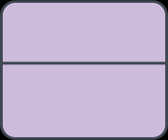
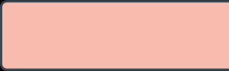
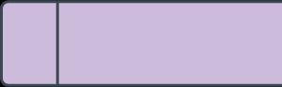
DFD Notations
S.No | Name | Description | Notation Yourdon and Coad | Gane and Sarson
1 | External Entity | An outside system that sends or receives data, communicating with the system being diagrammed. They are the sources and destinations of information entering or leaving the system. They might be an outside organization or person, a computer system or a business system. They are also known as terminators, sources and sinks or actors. They are typically drawn on the edges of the diagram.
2 | Process | Any process that changes the data, producing an output. It might perform computations, or sort data based on logic, or direct the data flow based on business rules
3 | Data store | Files or repositories that hold information for later use, such as a database table or a membership form.
4 | Data flow | The route that data takes between the external entities, processes and data stores.

Slide 54
DFD Rules and Tips
Each process should have at least one input and an output.
Each data store should have at least one data flow in and one data flow out.
Data stored in a system must go through a process.
All processes in a DFD go to another process or a data store.

Slide 55
DFD
A data flow diagram can dive into progressively more detail by using levels and layers, zeroing in on a particular piece. DFD levels are numbered 0, 1 or 2, and occasionally go to even Level 3 or beyond.
Level 0
Level 1
Level 2

Slide 56
Data-processing models
Data flow diagrams are used to model the system’s data processing
These show the processing steps as data flows through a system
Intrinsic part of many analysis methods
Simple and intuitive notation that customers can understand
Show end-to-end processing of data

Slide 57
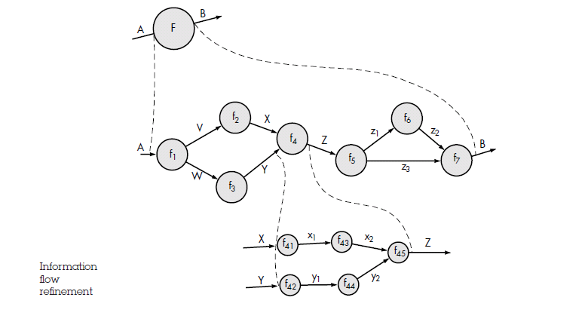
Data Flow Diagram

Slide 58
DFD- Level 0
DFD Level 0 is also called a Context Diagram.
It’s a basic overview of the whole system or process being analyzed or modeled.
It’s designed to be an at-a-glance view, showing the system as a single high-level process, with its relationship to external entities.
It should be easily understood by a wide audience, including stakeholders, business analysts, data analysts and developers.

Slide 59
DFD- Level 1
DFD Level 1 provides a more detailed breakout of pieces of the Context Level Diagram.
You will highlight the main functions carried out by the system, as you break down the high-level process of the Context Diagram into its sub processes.

Slide 60
DFD- Level 2
DFD Level 2 then goes one step deeper into parts of Level 1. It may require more text to reach the necessary level of detail about the system’s functioning.

Slide 61
Example DFD : Safe home Software
Safe Home software enables the homeowner to configure the security system when it is
installed, monitors all sensors connected to the security system, and interacts with the homeowner
through a keypad and function keys contained in the Safe Home control panel
During installation, the Safe Home control panel is used to "program" and configure the
system. Each sensor is assigned a number and type, a master password is programmed for
arming and disarming the system, and telephone number(s) are input for dialing when a
sensor event occurs.
When a sensor event is recognized, the software invokes an audible alarm attached to
the system. After a delay time that is specified by the homeowner during system configuration
activities, the software dials a telephone number of a monitoring service, provides information
about the location, reporting the nature of the event that has been detected. The
telephone number will be redialed every 20 seconds until telephone connection is obtained.
All interaction with SafeHome is managed by a user‐interaction subsystem that reads
input provided through the keypad and function keys, displays prompting messages on the
LCD display, displays system status information on the LCD display.

Slide 62
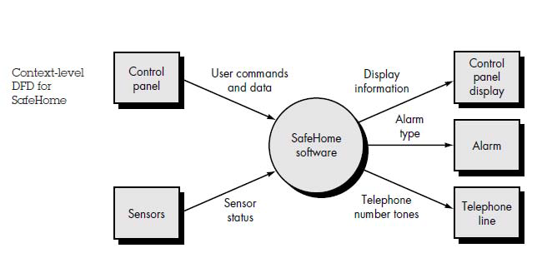
Level 0 DFD

Slide 63
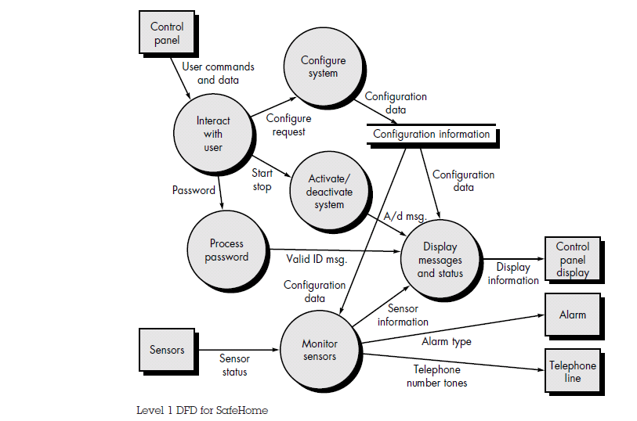
Level 1 DFD

Slide 64
Entity Relationship Diagrams
An ERD shows the relationships of entity sets stored in a database.
An entity in this context is an object, a component of data.
An entity set is a collection of similar entities.
These entities can have attributes that define its properties.
ER diagram illustrates the logical structure of databases.
ER diagrams are used to sketch out the design of a database.

Slide 65
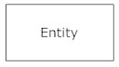
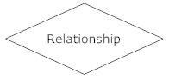
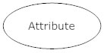
ER Diagram Notations
Entities : is an object or concept about which you want to store information.
Actions, which are represented by diamond shapes, show how two entities share information in the database.
Attributes, which are represented by ovals. A key attribute is the unique, distinguishing characteristic of the entity.
A multivalued attribute can have more than one value. For example, an employee entity can have multiple skill values.
A derived attribute is based on another attribute. For example, an employee's monthly salary is based on the employee's annual salary.
Connecting lines, solid lines that connect attributes to show the relationships of entities in the diagram.

Slide 66
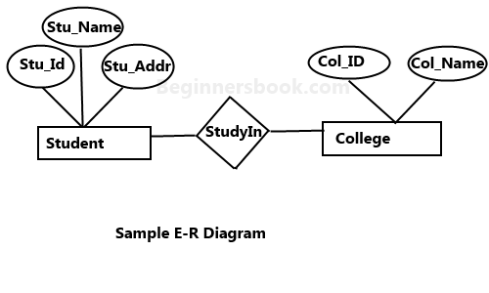
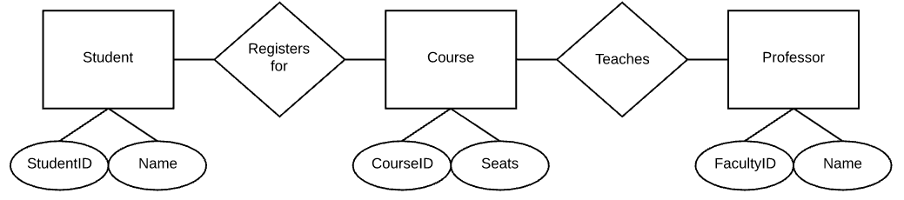
ER Diagram

Slide 67
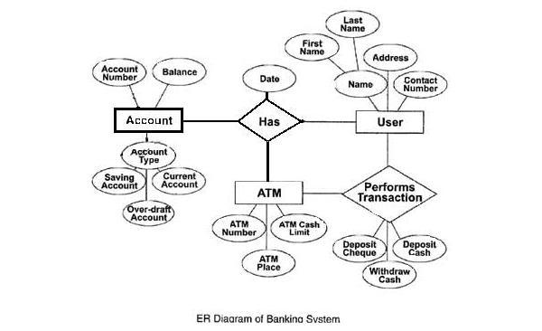
ER Diagram

Slide 68
UML-History
CASE Tools: Automation of Software Development
People-to-People
People-to-Computer
Rational Software (An IBM Company)
Rational Rose / MS Visio:
Converting UML-Diagrams-to-Programs
OMG: Object Management Group
UML: an open standard controlled by OMG
UML 1.0 (1997)
UML 2.0 (2004)
…..

Slide 69
Object Oriented Analysis and design
Object-oriented analysis is a process that groups items that interact with one another, typically by class, data or behavior, to create a model that accurately represents the system .
The focus is on capturing the structure and behavior of systems into small modules that combines both data and process.

Slide 70
OOAD :Object Modelling
The process of object modelling can be visualized in the following steps −
Identify objects and group into classes
Identify the relationships among classes
Create user object model diagram
Define user object attributes
Define the operations that should be performed on the classes

Slide 71
Dynamic Modelling
After the static behavior of the system is analyzed, its behavior with respect to time and external changes needs to be examined. This is the purpose of dynamic modelling.
Dynamic Modelling can be defined as “a way of describing how an individual object responds to events, either internal events triggered by other objects, or external events triggered by the outside world”.
The process of dynamic modelling can be visualized in the following steps −
Identify states of each object
Identify events and analyze the applicability of actions
Construct dynamic model diagram, comprising of state transition diagrams
Express each state in terms of object attributes
Validate the state–transition diagrams drawn

Slide 72
Functional Modelling
Functional Modelling is the final component of object-oriented analysis. The functional model shows the processes that are performed within an object and how the data changes as it moves between methods. It specifies the meaning of the operations of object modelling and the actions of dynamic modelling. The functional model corresponds to the data flow diagram of traditional structured analysis.
The process of functional modelling can be visualized in the following steps −
Identify all the inputs and outputs.
Construct data flow diagrams showing functional dependencies.
State the purpose of each function.
Identify constraints.
Specify optimization criteria.

Slide 73
SSAD vs OOAD
The Structured Analysis/Structured Design (SASD) approach is the traditional approach of software development based upon the waterfall model. The phases of development of a system using SASD are −
Feasibility Study
Requirement Analysis and Specification
System Design
Implementation
Post-implementation Review

Slide 74
Benefits of OOAD
Advantages | Disadvantages
Focuses on data rather than the procedures as in Structured Analysis. | Functionality is restricted within objects. This may pose a problem for systems which are intrinsically procedural or computational in nature.
The principles of encapsulation and data hiding help the developer to develop systems that cannot be tampered by other parts of the system. | It cannot identify which objects would generate an optimal system design.
The principles of encapsulation and data hiding help the developer to develop systems that cannot be tampered by other parts of the system. | The object-oriented models do not easily show the communications between the objects in the system.
It allows effective management of software complexity by the virtue of modularity. | All the interfaces between the objects cannot be represented in a single diagram.
It can be upgraded from small to large systems at a greater ease than in systems following structured analysis.

Slide 75
What is UML?
UML (Unified Modeling Language)
An emerging standard for modeling object-oriented software.
Resulted from the convergence of notations from three leading object-oriented methods:
OMT (James Rumbaugh)
OOSE (Ivar Jacobson)
Booch (Grady Booch)
Reference: “The Unified Modeling Language User Guide”, Addison Wesley, 1999.
Supported by several CASE tools
Rational ROSE
TogetherJ

Slide 76
UML Concepts
UML can be used to support your entire life cycle
The interaction of your application with the outside world (use case diagram)
Visualize object interaction (sequence & collaboration diagrams)
The structure of your system (class diagram)
View the system architecture by looking at the defined package.
The components in your system (component diagram)

Slide 77
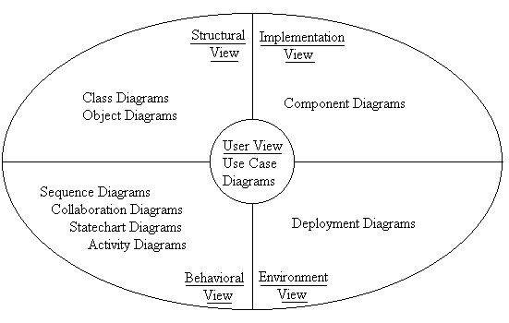
UML supported diagrams
UML Meta Model: A diagram that defines the notation to be used in the modeling language

Slide 78
Model Terminology
User model view - problem and solution from the perspective of the users.
Structural model view - static or structural aspects of a problem and solution.
Behavioral model view - dynamic or behavioral aspects; interactions or collaborations among problem and solution elements.
Implementation model view - structural and behavioral aspects of the solution’s realization.
Environment model view - structural and behavioral aspects of the domain in which a solution must be realized.

Slide 79
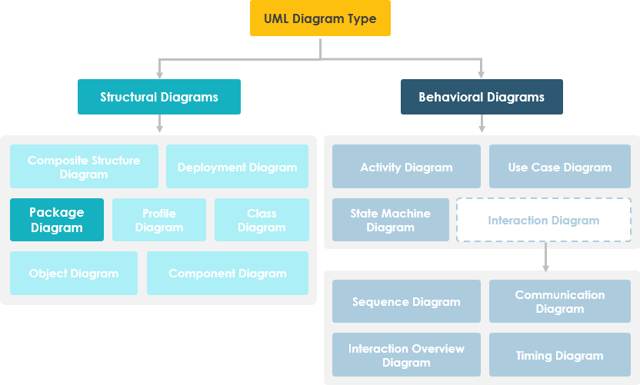
UML Diagrams
Graphical presentation of model elements.
A diagram is a graphical means to view a system’s parts

Slide 80
Brief Overview
Class - Set of classes, interfaces, collaboration, relationships.
Object - Set of objects and their relationships.
Use case - Description of functionality provided by system along with actors and their connection to the use case.
Interaction - Set of objects and their relationships including messages.
State/state chart - A state machine showing states, transitions, events, and activities.
Activity – State chart sequential flow of activities.
Component - Physical structure of code in terms of code components.
Deployment - Physical architecture of hardware and software in the system.
Package - Shows packages of classes and dependencies among them
Grouping mechanism
Form of class diagram
Also called subsystem

Slide 81
Use Case Diagram
A use case diagram describes how a system interacts with outside actors.
It is a graphical representation of the interaction among the elements and system.
Each use case represents a piece of functionality that a system provides.
The use case diagram allows for the specification of higher level user goals.
A use case diagram contains four components
The boundary
The actor
The use case
The relationship between and among the actors and the use cases

Slide 82
Use Case Diagram
S.No | Name | Description | Notation
1 | System Boundary | The scope of a system can be represented by a system boundary
2 | Use case | A sequences of actions (it must be a verb)
3 | Actor | User (or) someone / something outside the system that interacts with the system (it must be a noun)
4 | Association | It corresponds to a sequence of actions between the actor and use case
5 | Generalization | Inheritance relationship between model elements of same type
PurchaseTicket

Slide 83
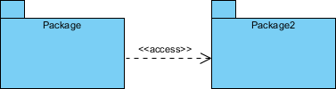
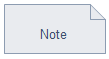
Use Case Diagram
S.No | Name | Description | Notation
6 | Include | It specifies how the behavior of the inclusion use case is inserted into the behavior defined for the base use case | <<include>>
7 | Extend | How the behavior of the extension use case can be inserted into the behavior defined for the base use case | <<extend>>
8 | Package | Package is defined as a collection of classes. Classes are unified together using a package
9 | Note | Note is generally used to write comment in use case diagram

Slide 84
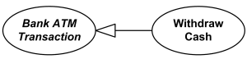
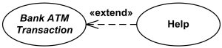


Slide 85
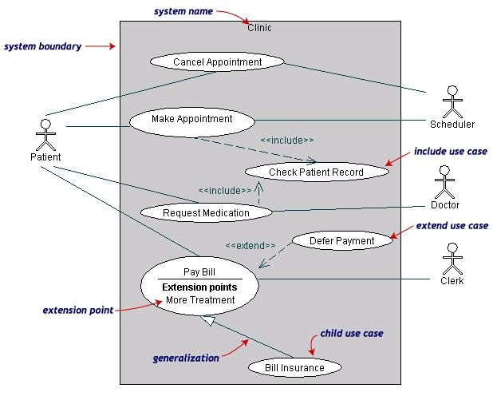
Use Case Diagram
Both Make Appointment and Request Medication include Check Patient Record as a subtask (include)
The extension point is written inside the base case Pay bill; the extending class Defer payment adds the behavior of this extension point. (extend)
Pay Bill is a parent use case and Bill Insurance is the child use case. (generalization)

Slide 86
Class Diagram
A class diagram depicts classes and their interrelationships.
Used for describing structure and behavior in the use cases.
Provide a conceptual model of the system in terms of entities and their relationships.
Used for requirement capture, end-user interaction.
Detailed class diagrams are used for developers

Slide 87
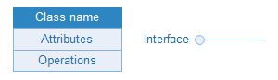
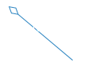

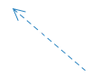
Class Diagram
S.No | Name | Description | Notation
1 | Classes and interface | They are used to show the different objects in a system, their attributes, their operations and the relationships among them.
2 | Object | An object is an instance or occurrence of a class
3 | Aggregation | An aggregation describes a group of objects and how you interact with them.
4 | Composition | Composition represents whole-part relationships and is a form of aggregation.
5 | Dependency | Dependency relationship is a relationship in which one element, the client, uses or depends on another element, the supplier.
Object: Class

Slide 88
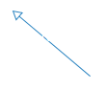
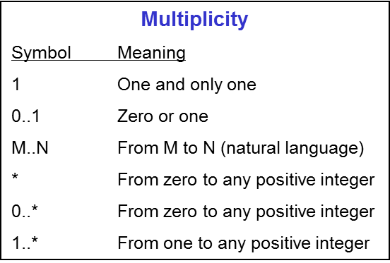
Class Diagram
S.No | Name | Description | Notation
3 | Generalization | Generalization is a relationship in which one model element (the child) is based on another model element (the parent).
4 | Association | Association is a relationship between two classifiers, such as classes or use cases, that describes the reasons for the relationship and the rules that govern the relationship.
5 | Multiplicity

Slide 89
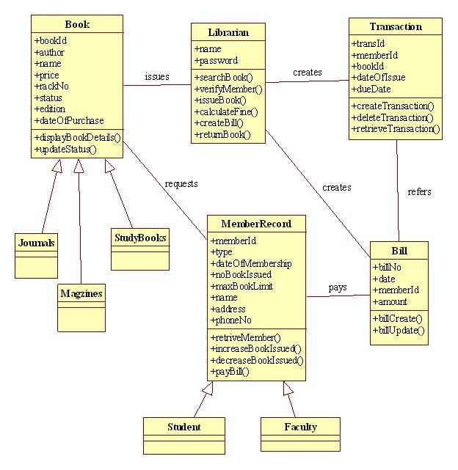
Class Diagram

Slide 90
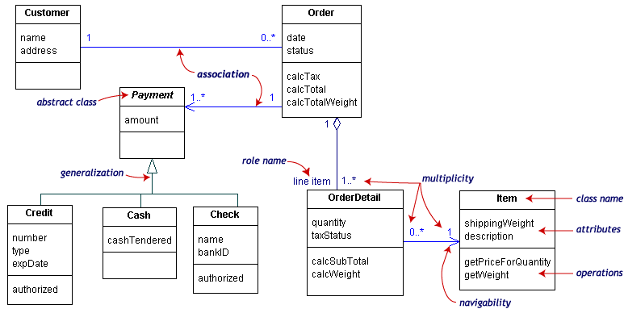
UML Class Example

Slide 91
UML Sequence Diagrams
Sequence diagrams model the dynamic aspects of a software system.
The emphasis is on the “sequence” of messages rather than relationship between objects.
Sequence diagrams provide more detail and show the message exchanged among a set of objects over time.
The main purpose of this diagram is to represent how different business object interacts.

Slide 92
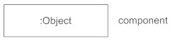
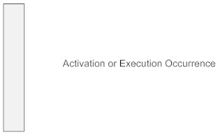

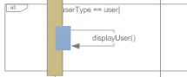
UML Sequence Diagrams
S.No | Name | Description | Notation
1 | Class Roles or Participants | Class roles describe the way an object will behave in context
2 | Activation or Execution Occurrence/ Scope | Activation boxes represent the time an object needs to complete a task.
3 | Messages | Messages are arrows that represent communication between objects.
4 | Lifelines | Lifelines are vertical dashed lines that indicate the object's presence over time.
5 | Destroying Objects | Objects can be terminated early using an arrow labeled "<< destroy >>" that points to an X.
6 | Loops | A repetition or loop within a sequence diagram is depicted as a rectangle. Place the condition for exiting the loop at the bottom left corner in square brackets [ ].

Slide 93
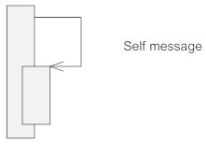
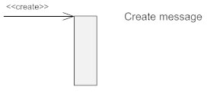
UML Sequence Diagrams- Types of Messages in Sequence Diagrams
S.No | Name | Description | Notation
1 | Synchronous Message | A synchronous message requires a response before the interaction can continue.
2 | Asynchronous Message | Asynchronous messages don't need a reply for interaction to continue.
3 | Reply or Return Message | A reply message is drawn with a dotted line and an open arrowhead pointing back to the original lifeline.
4 | Self Message | A message an object sends to itself, usually shown as a U shaped arrow pointing back to itself.
5 | Create Message | This is a message that creates a new object

Slide 94
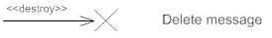
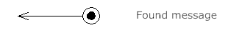
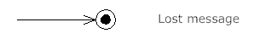
UML Sequence Diagrams- Types of Messages in Sequence Diagrams
S.No | Name | Description | Notation
6 | Delete Message | This is a message that destroys an object. It can be shown by an arrow with an x at the end.
7 | Found Message | A message sent from an unknown recipient, shown by an arrow from an endpoint to a lifeline.
8 | Lost Message A message sent to an unknown recipient. | It's shown by an arrow going from a lifeline to an endpoint, a filled circle or an x
.

Slide 95
Sequence Diagram
Used during requirements analysis
To refine use case descriptions
to find additional objects (“participating objects”)
Used during system design
to refine subsystem interfaces
Classes are represented by rectangles
Messages are represented by arrows
Activations are represented by narrow rectangles
Lifelines are represented by dashed lines

Slide 96
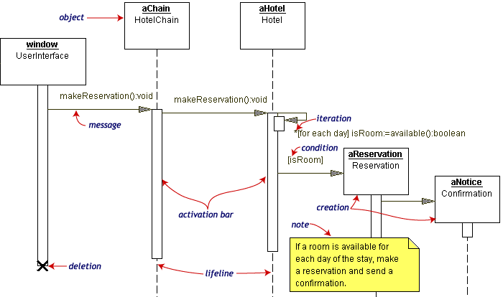
Sequence Diagram Example
Hotel Reservation

Slide 97
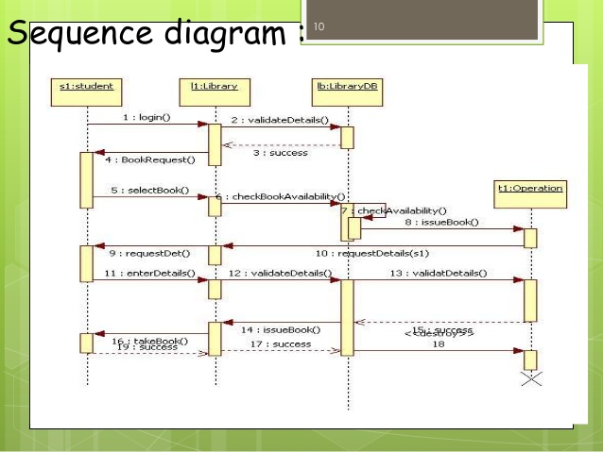
Sequence Diagram To Issue Book From Library

Slide 98
Activity Diagrams
Normally employed in business process modelling.
An activity diagram visually presents a series of actions or flow of control in a system similar to a flowchart or a data flow diagram.
Activity diagrams are often used in business process modeling.
They can also describe the steps in a use case diagram.
Activities modeled can be sequential and concurrent.
In both cases an activity diagram will have a beginning (an initial state) and an end (a final state).

Slide 99

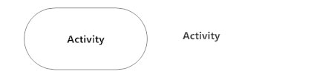

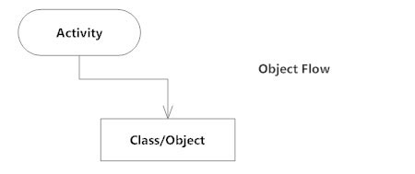
Activity Diagrams
S.No | Name | Description | Notation
1 | Initial State or Start Point | Represents the initial action state or the start point for any activity diagram
2 | Activity or Action State | An action state represents the non-interruptible action of objects.
3 | Action Flow | Action flows, also called edges and paths, illustrate the transitions from one action state to another
4 | Object Flow | Object flow refers to the creation and modification of objects by activities. An object flow arrow from an action to an object means that the action creates or influences the object.

Slide 100



Activity Diagrams
S.No | Name | Description | Notation
5 | Decisions and Branching | When an activity requires a decision prior to moving on to the next activity, add a diamond between the two activities.
6 | Guards | In UML, guards are a statement written next to a decision diamond that must be true before moving next to the next activity.
7 | Synchronization | A fork node is used to split a single incoming flow into multiple concurrent flows. A join node joins multiple concurrent flows back into a single outgoing flow.

Slide 101



Activity Diagrams
S.No | Name | Description | Notation
8 | Merge Event | A merge event brings together multiple flows that are not concurrent.
9 | Final State or End Point | An arrow pointing to a filled circle nested inside another circle represents the final action state
10 | Swimlanes | Swimlanes group related activities into one column.

Slide 102

Activity Diagram- Example

Slide 103
State Chart Diagram
A state diagram shows the behavior of classes in response to external stimuli.
Specifically a state diagram describes the behavior of a single object in response to a series of events in a system.
Sometimes it's also known as a Harel state chart or a state machine diagram.
This UML diagram models the dynamic flow of control from state to state of a particular object within a system.

Slide 104



State Chart Diagram
S.No | Name | Description | Notation
1 | States | States represent situations during the life of an object.
2 | Transition | A solid arrow represents the path between different states of an object.
3 | Initial State | A filled circle followed by an arrow represents the object's initial state.
4 | Final State | An arrow pointing to a filled circle nested inside another circle represents the object's final state.

Slide 105
State Chart Diagram
Elements of state chart diagram
Initial State: A filled circle
Final State: A filled circle inside a larger circle
State: Rectangle with rounded corners
Transitions: Arrow between states, also boolean logic condition (guard)‏

Slide 106

State Chart Diagram- Example

Slide 107
References
Ian Sommerville, ― Software Engineering‖, Addison and Wesley. 9th Ed., 2011.
Roger S Pressman, Software Engineering: A Practitioner’s Approach, Mcgraw-Hill, ISBN: 0073375977, Seventh Edition, 2014
Pankaj Jalote, Software Engineering: A Precise Approach, Wiley India.2010.

